Slide 1
PC Maintenance: Preparing for A+ Certification
Chapter 17: Keyboards and Mice

Slide 2
Chapter 17 Objectives
Understand keyboard and mouse functionality
Identify types of keyboards and mice
Connect and disconnect keyboards and mice
Troubleshoot common problems with keyboards and mice

Slide 3
How Keyboards Work
Grid of uncompleted circuits
Pressing a key completes the circuit
Each key sends a different signal
Modifier keys (Shift, Ctrl) change the signal that is sent by another key

Slide 4
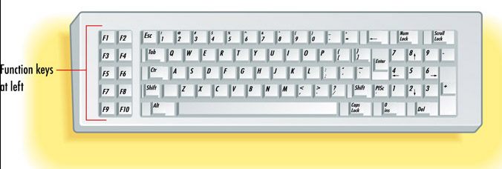
Keyboard Layouts
XT Keyboard, function keys at left, no separate arrow pad

Slide 5
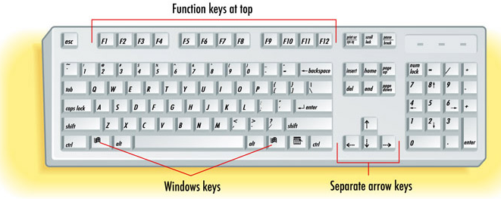
Keyboard Layouts
Windows Keyboard, has function keys on top, Windows keys, separate arrow keys

Slide 6
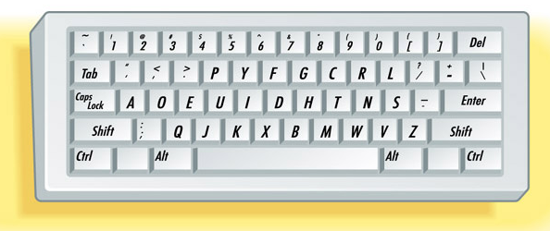
Keyboard Layouts
Dvorak keyboard, different arrangement of keys, requires user retraining, faster typing (by some claims)

Slide 7
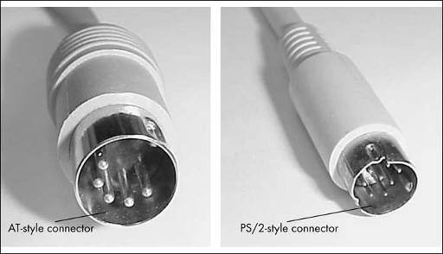
Keyboard Connectors
AT-style (older, larger)
PS/2-style (newer, smaller)
USB (newest)

Slide 8
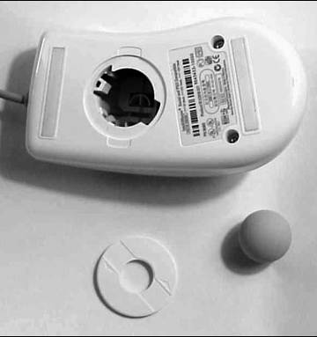
Standard Ball Mouse
Ball rolls past sensors that send electrical pulses to PC
Ball removable for cleaning

Slide 9
Optical Mouse
Light sensor instead of ball
Sealed case, no cleaning required
Lasts longer than a traditional mouse (in theory)

Slide 10
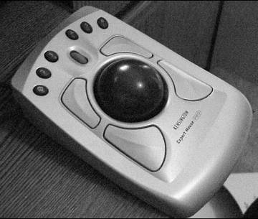
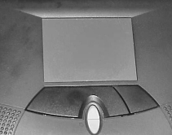
Mouse Variants
Trackball
Touchpad
Light pen

Slide 11
Connecting/Disconnecting
USB models can be connected without shutting down PC
PS/2 mouse can be connected without powering down if Windows fails to detect a mouse at startup
All other connections/disconnections must be done with power off

Slide 12
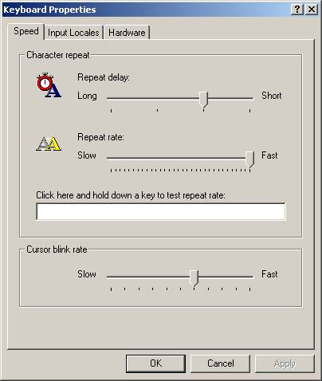
Adjusting Keyboard in Windows
Keyboard properties in Control Panel
Repeat Delay
Repeat Rate
Cursor Blink Rate

Slide 13
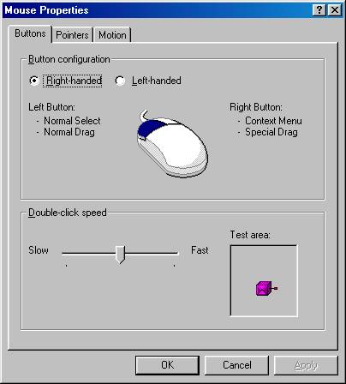
Adjusting Mouse in Windows
Buttons:
  Swap right and left
  Double-click speed
Pointer Appearance
Pointer Movement

Slide 14
Troubleshoot Keyboard Problems
Keyboard not detected
  Check connection
  Bad keyboard
Stuck key message at startup
  Object resting on keyboard
  Dirt or object wedged into keys
Nonresponsive key
  Clean keyboard

Slide 15
Troubleshooting Keyboard Problems
Wrong letters appear when typing
  Check keyboard layout chosen in Windows
  Remove keyboard from Device Manager and redetect
  Bad keyboard (faulty controller chip inside)
Spilled liquid on keyboard
  If sugared liquid, clean with soap and water
  Let dry completely
  Replacement might be necessary

Slide 16
Troubleshooting Mouse Problems
Pointer does not move at all
  Mouse disconnected
  Windows locked up (reboot)
  Bad mouse
Pointer moves in only one direction
  Mouse requires cleaning
  Roller inside is malfunctioning (clean, replace entire mouse)

Slide 17
Troubleshooting Mouse Problems
Pointer jumps erratically all over screen
  Dirty mouse
  Bad or incompatible video driver
  Check in Safe Mode to eliminate driver as possibility
Extra buttons do not work
  Software for mouse not installed
Touchpad does not click when tapping
  Software or driver not installed

